Slide 1
OBSTACLE AVOIDER REVIEW 3
DONE BY :
ROSHAN SURYA – 19BCE1583
SOMESH VIJAY – 19BCE1157
ASWIN CHANDER – 19BCE1034
Yeshwanth p – 19BCE1862

Slide 2
ABSTRACT
Obstacle avoiding robot was designed, constructed and programmed which may be potentially used for educational and research purposes. The developed robot will move in a particular direction once the infrared (IR) and the PIR passive infrared (PIR) sensors sense a signal while avoiding the obstacles in its path. The robot can also perform desired tasks in unstructured environments without continuous human guidance. The hardware was integrated in one application board as embedded system design. The software was developed using C++ and compiled by Arduino IDE 1.6.5. The main objective of this project is to provide simple guidelines to the polytechnic students and beginners who are interested in this type of research. It is hoped that this robot could benefit students who wish to carry out research on IR and PIR sensors

Slide 3
OBJECTIVE
TO MAKE AN OBSTACLE AVOIDING ROBOT WHICH USES IR SENSOR TO AVOID OBJECTS WITHIN ITS VICINITY.
TO USE AN ARDUINO BOARD IN ORDER TO INTEGRATE THE MICROCONTROLLER AND THE REQUIRED CONNECTIONS BETWEEN IR SENSORS ,MOTORS AS WELL AS THE BODY OF THE ROBOT
TO CODE A PROGRAM FOR THE IR SENSOR TO WORK USING ARDUINO AND UPLOADING THE CODE INTO THE ROBOT USING USB A-B CABLE

Slide 4
HARDWARE AND SENSORS USED
IR SENSOR : USED TO DETECT OBJECT USING HIGH AND LOW COMMANDS SO THAT THE ROBOT CAN AVOID OBJECTS AND MOVE
ARDUINO BOARD : TO INTEGRATE ARDUINO PROGRAM INTO IT
MICROCONTROLLER:TO CONNECT ALL THE IR SENSOR AND THE MOTOR SO THAT AL ARE INTACT AND THE ROBOT CAN MOVE
POWER BANK : TO MAKE THE ROBOT MOVE AND FOR PROVIDING POWER TO THE BOARD

Slide 5
SOFTWARE USED
ARDUINO SOFTWARE IS USED IN ORDER TO CODE
HIGH AND LOW COMMANDS ARE USED FOR CODING THE IR SENSORS SO THAT THEY RESPOND ACCORDINGLY
HARDWARE PART : 3 IR SENSORS ARE USED IN ORDER
INPUT FOR THE IR SENSOR IS BASED ON 0’S AND 1’S OR HIGH AND LOW.
THE ROBOT WILL WORK BASED ON BINARY VALUES
FOR EG. IF ALL THE SENSORS READ 0 , IT WILL MOVE FRONT , IF IT IS 1 , IT WILL MOVE RIGHT ETC..

Slide 6
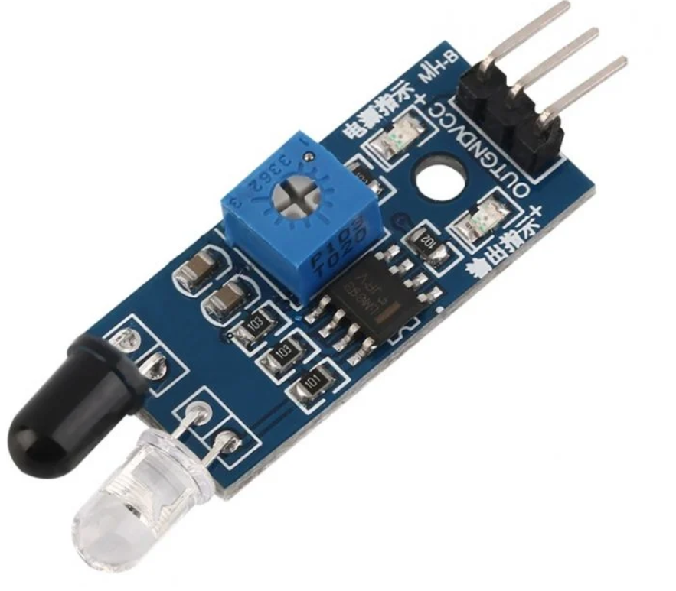
WHAT IS AN IR SENSOR?
An IR sensor is an electronic device, which illuminates light to detect the surrounding environment. The IR sensor can measure the temperature of an object and detect movement. Usually, in the infrared spectrum, all substances emit a certain type of radiation. These types of radiation are invisible to our eyes, but the infrared sensor can detect these rays.

Slide 7
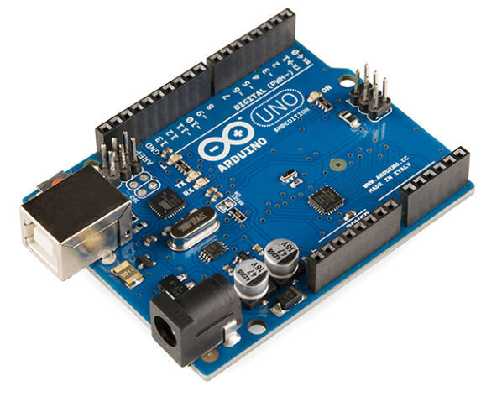
WHAT IS AN MICROCONTROLLER
Arduino consists of both a physical programmable circuit board (often referred to as a microcontroller) and a piece of software, or IDE (Integrated Development Environment) that runs on your computer, used to write and upload computer code to the physical board.

Slide 8
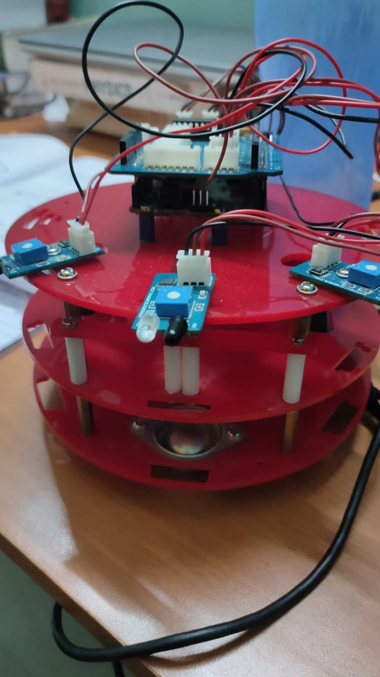
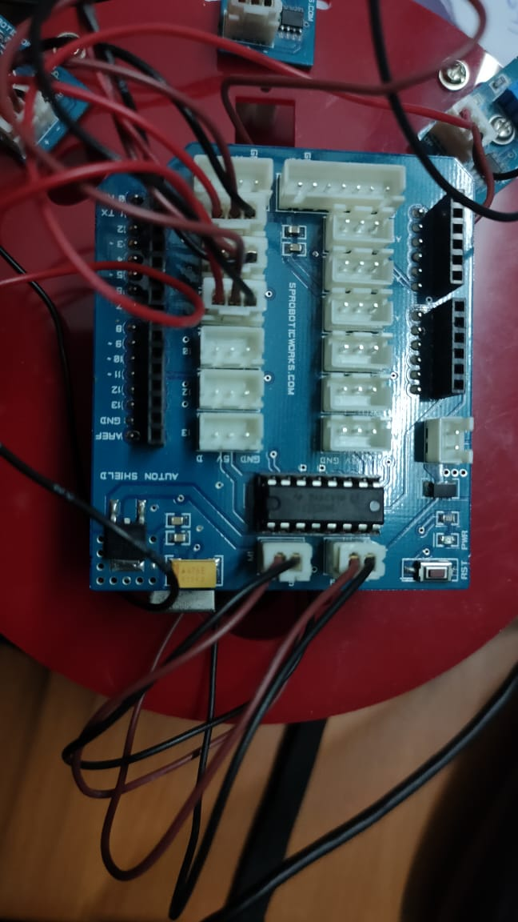
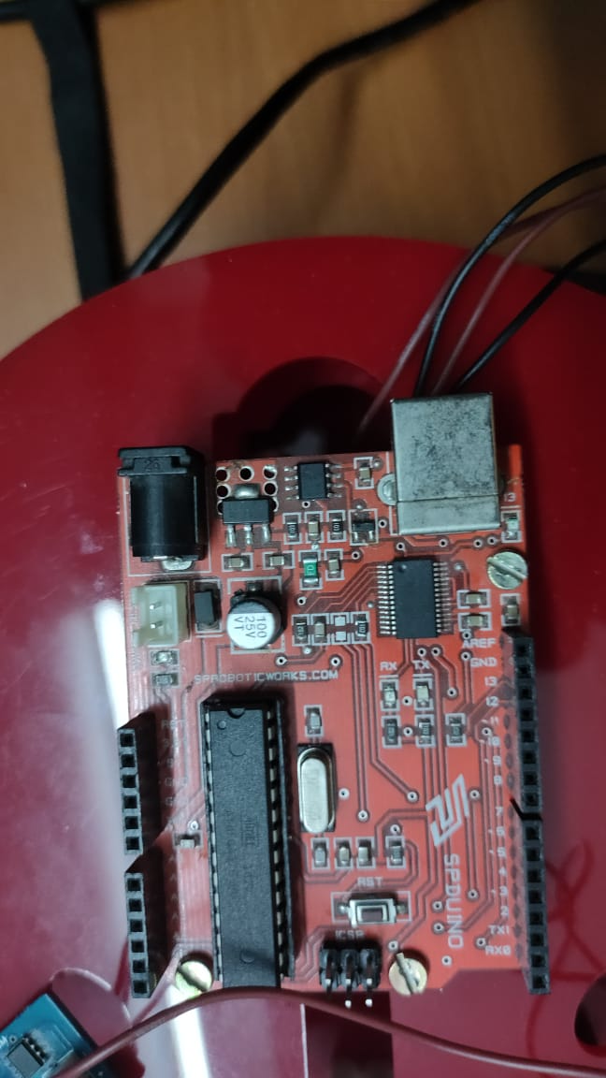
OBSTACLE AVOIDER

Slide 9
OBSTACLE AVOIDER
PORT : COM3
BOARD : ARDUINO UNO
IR SENSORS
MICROCONTROLLER
CONNECTING WIRES
BODY
WHEELS
DC MOTOR

Slide 10
WHERE IS OBSTACLE AVOIDER USED
In robotics, obstacle avoidance is the task of satisfying some control objective subject to non-intersection or non-collision position constraints. In unmanned air vehicles, it is a hot topic. What is critical about obstacle avoidance concept in this area is the growing need of usage of unmanned aerial vehicles in urban areas for especially military applications where it can be very useful in city wars. Normally obstacle avoidance is considered to be distinct from path planning in that one is usually implemented as a reactive control law while the other involves the pre-computation of an obstacle-free path which a controller will then guide a robot along. With recent advanced in the autonomous vehicles sector, a good and dependable obstacle avoidance feature of a driverless platform is also required to have a robust obstacle detection module.

Slide 11
CODE PART
void loop() {
ls = digitalRead(7);
cs = digitalRead(8);
rs = digitalRead(9);
if (ls == LOW && cs == LOW && rs == LOW)
{
forward();
}
else if (ls == HIGH && cs == LOW && rs == LOW)
{
right();
}
else if (ls == LOW && cs == LOW && rs == HIGH)
{
left();
}
int ls;
int cs;
int rs;
int lmt1 = 5;
int lmt2 = 3;
int rmt1 = 6;
int rmt2 = 11;
void setup() {
pinMode(7, INPUT);
pinMode(8, INPUT);
pinMode(9, INPUT);
pinMode(lmt1, OUTPUT);
pinMode(lmt2, OUTPUT);
pinMode(rmt1, OUTPUT);
pinMode(rmt2, OUTPUT);
}

Slide 12
CODE PART
else if (ls == LOW && cs == HIGH && rs == LOW)
{
reverse();
delay(200);
left();
delay(200);
}
else if (ls == HIGH && cs == HIGH && rs == LOW)
{
reverse();
delay(200);
right();
delay(200);
}
else if (ls == LOW && cs == HIGH && rs == HIGH)
{
reverse();
delay(200);
left();
delay(200);
}
else if (ls == HIGH && cs == LOW && rs == HIGH)
{
reverse();
delay(200);
left();
delay(200);
}

Slide 13
CODE PART
else if(ls == HIGH && cs == HIGH && rs == HIGH)
{
reverse();
delay(200);
left();
delay(200);
}
}

Slide 14
CODE PART
void forward()
{
digitalWrite(lmt1, HIGH);
digitalWrite(lmt2, LOW);
digitalWrite(rmt1, HIGH);
digitalWrite(rmt2, LOW);
}
void reverse()
{
digitalWrite(lmt1, LOW);
digitalWrite(lmt2, HIGH);
digitalWrite(rmt1, LOW);
digitalWrite(rmt2, HIGH);
}
void left()
{
digitalWrite(lmt1, LOW);
digitalWrite(lmt2, HIGH);
digitalWrite(rmt1, HIGH);
digitalWrite(rmt2, LOW);
}
void right()
{
digitalWrite(lmt1, HIGH);
digitalWrite(lmt2, LOW);
digitalWrite(rmt1, LOW);
digitalWrite(rmt2, HIGH);
}
void stp()
{
digitalWrite(lmt1, LOW);
digitalWrite(lmt2, LOW);
digitalWrite(rmt1, LOW);
digitalWrite(rmt2, LOW);
}
void stpleft()
{
digitalWrite(lmt1, LOW);
digitalWrite(lmt2, LOW);
digitalWrite(rmt1, HIGH);
digitalWrite(rmt2, LOW);
}

Slide 15
CODE PART
void stpright()
{
digitalWrite(lmt1, HIGH);
digitalWrite(lmt2, LOW);
digitalWrite(rmt1, LOW);
digitalWrite(rmt2, LOW);
}

Slide 16
THANK YOU

